Slide 1

Разработка виртуальных лабораторий для ГК «РОСНАНО»

Slide 2
Теоретическая составляющая с системой самоконтроля.
Описание обобщенного применяемого оборудования, оценка знания принципов работы.
3D-моделирование реальных установок, тренинг.
Проведение виртуальных экспериментов (виртуальная лабораторная работа), тренинг.
Контрольный виртуальный эксперимент. Определение уровня компетенции.

Slide 3
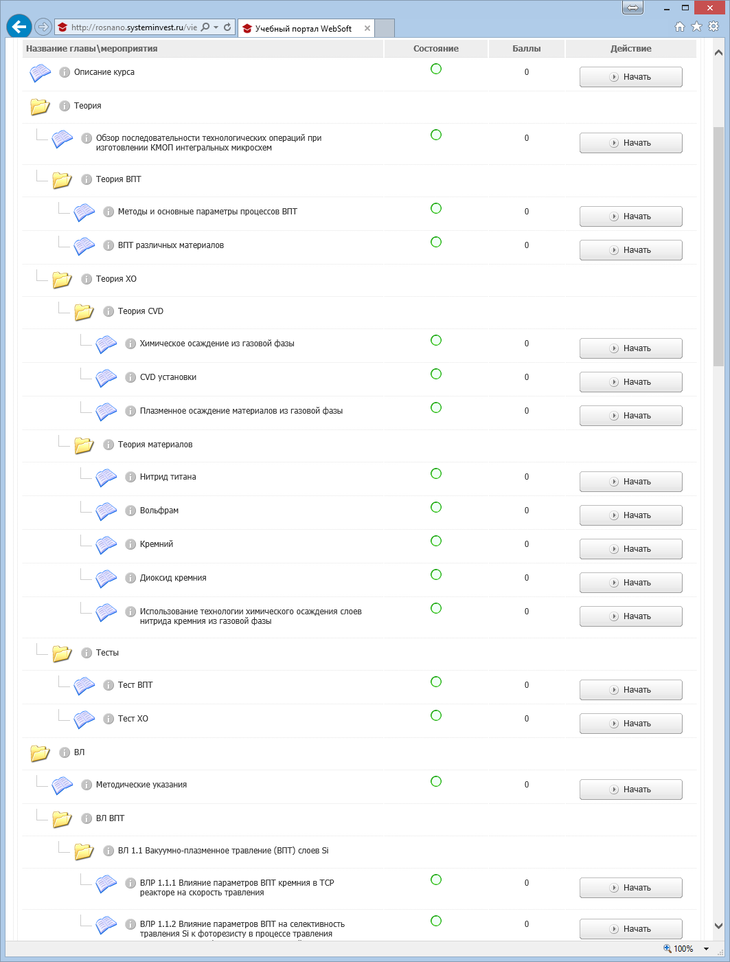
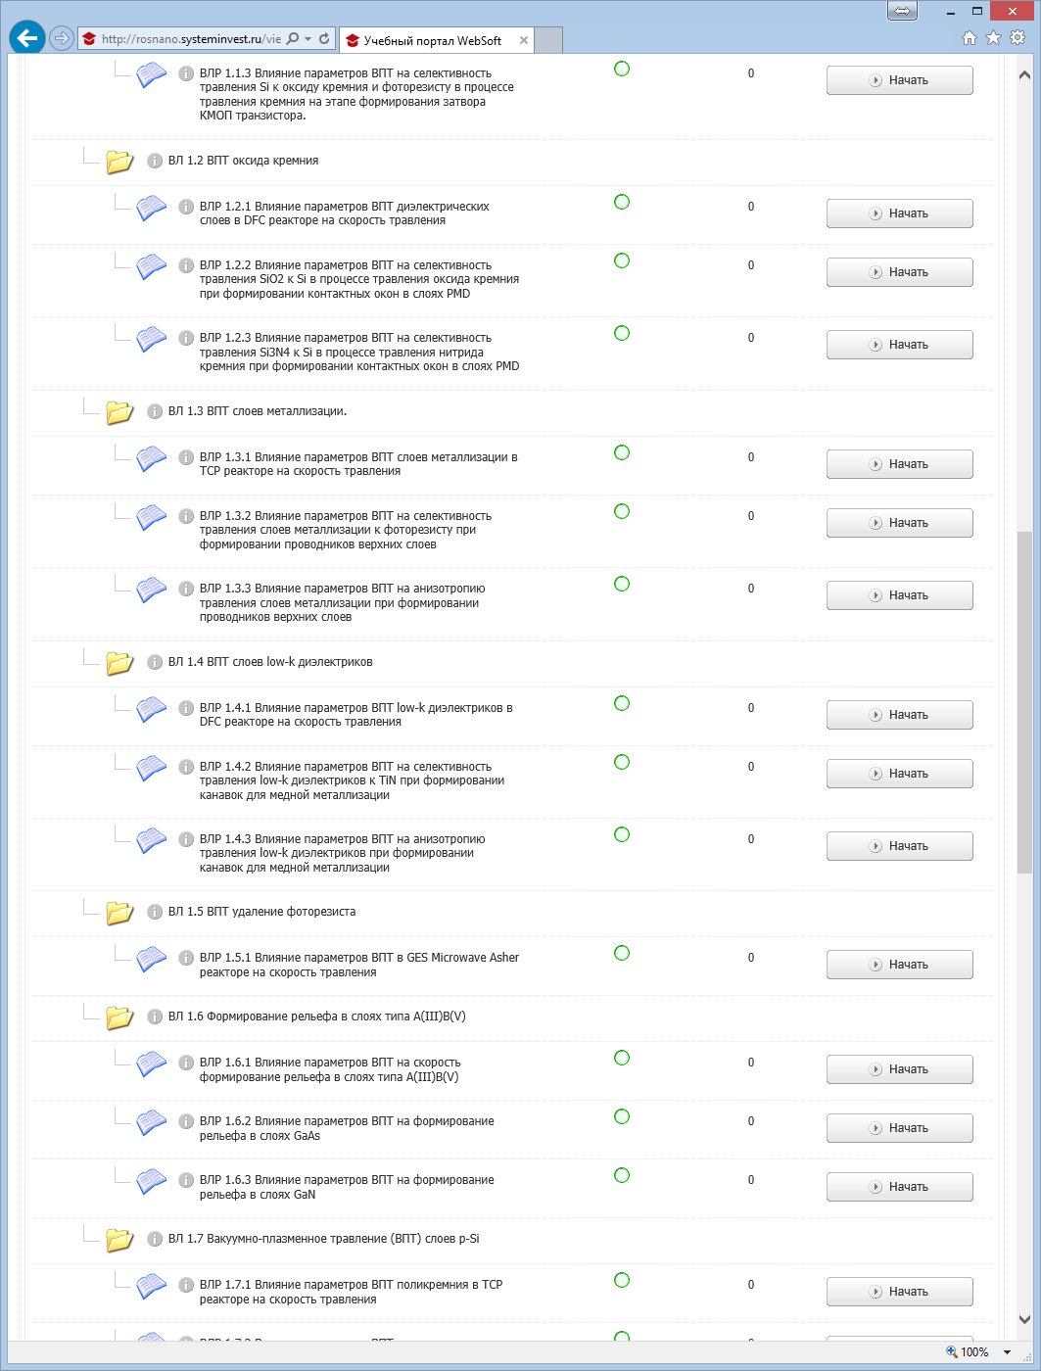
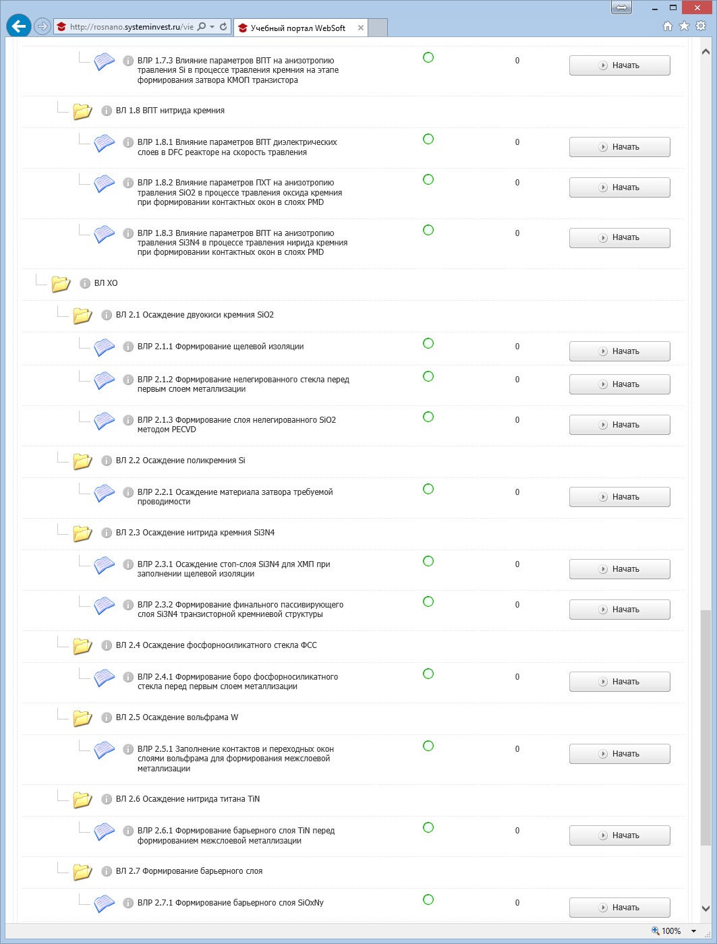

Slide 4
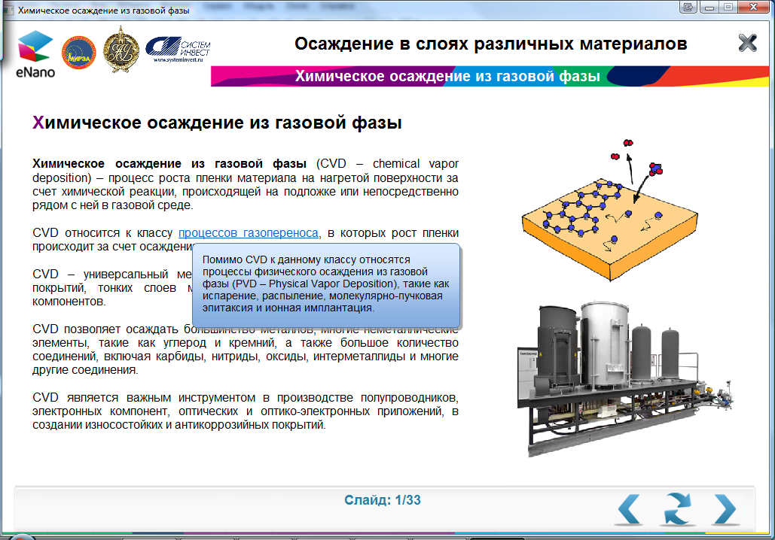
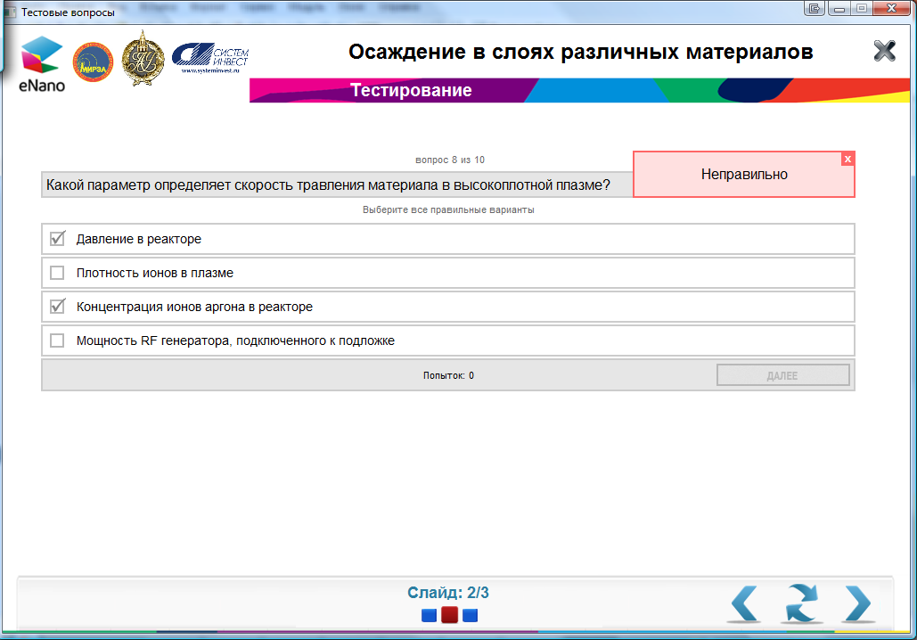
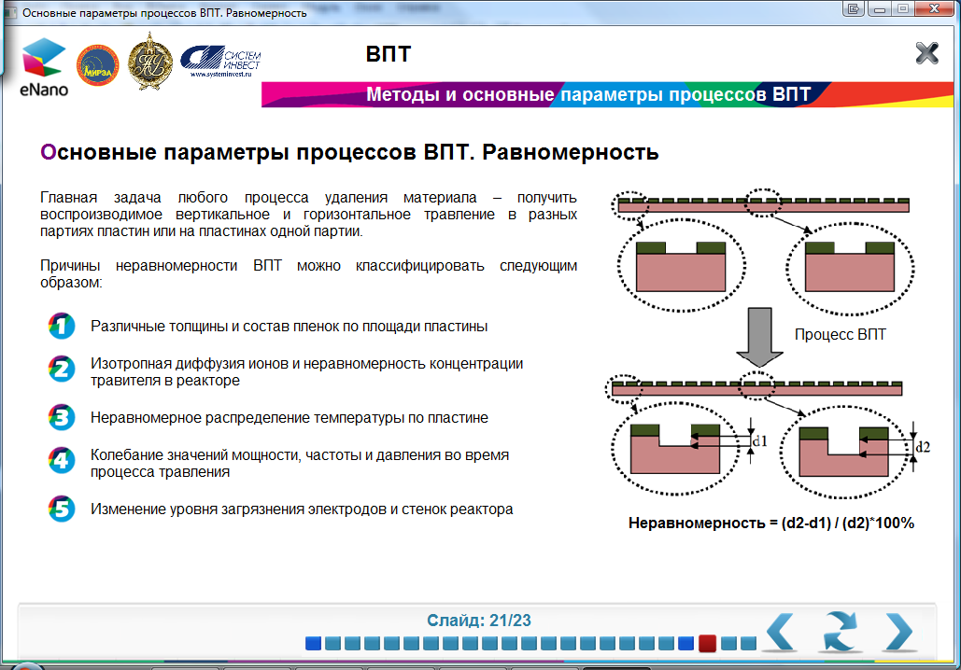
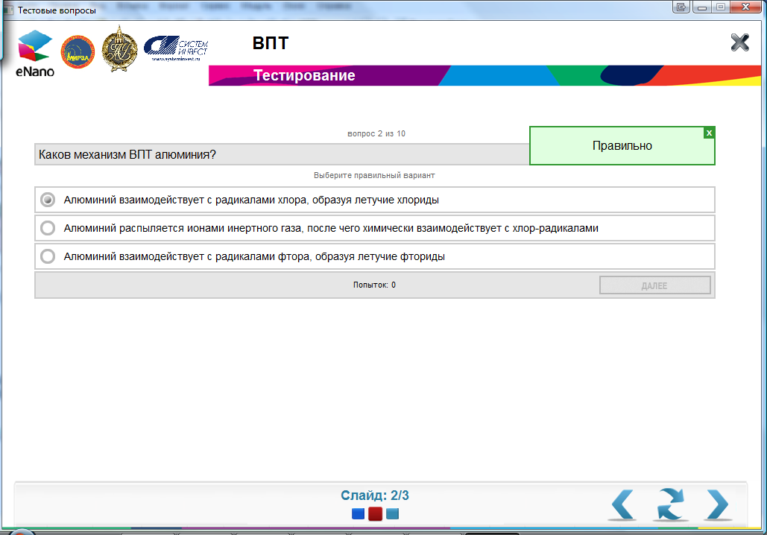
Тренинг (учебный курс)
Раздел теории
Раздел тестирования

Slide 5
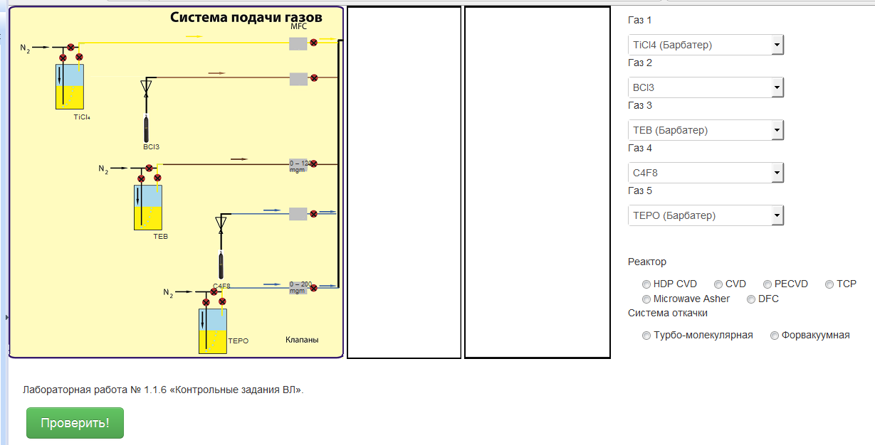
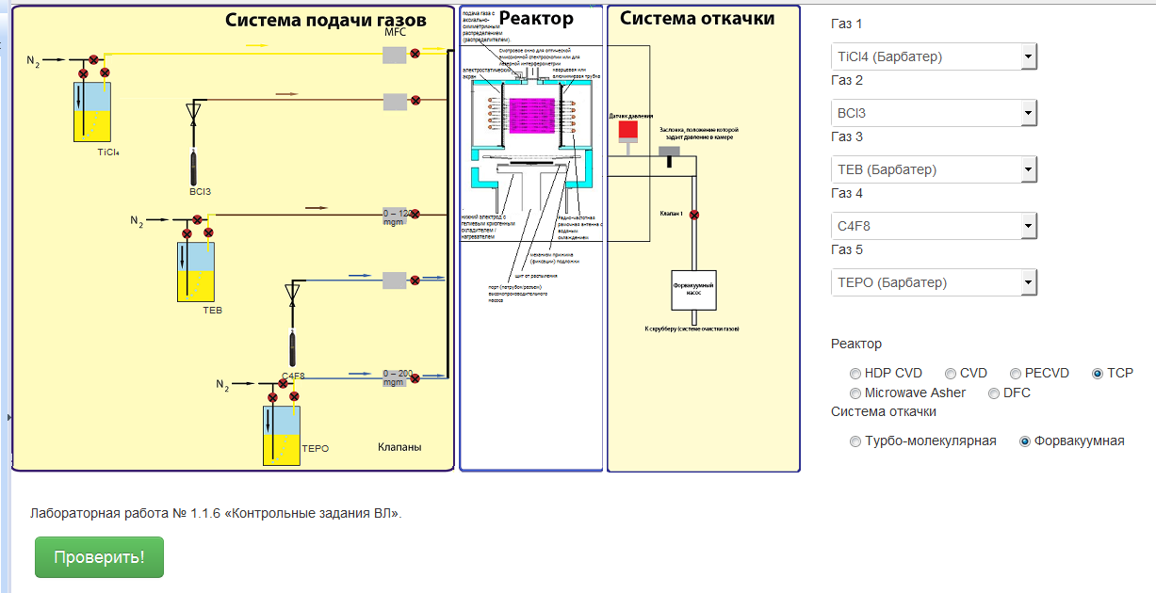
Модуль «Обобщенная установка»

Slide 6
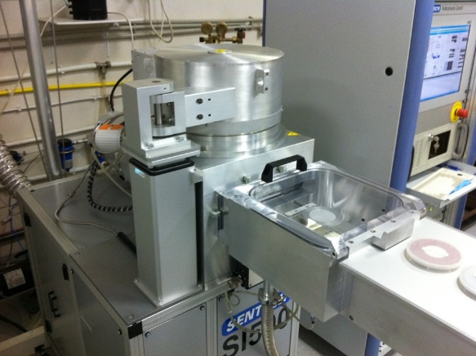
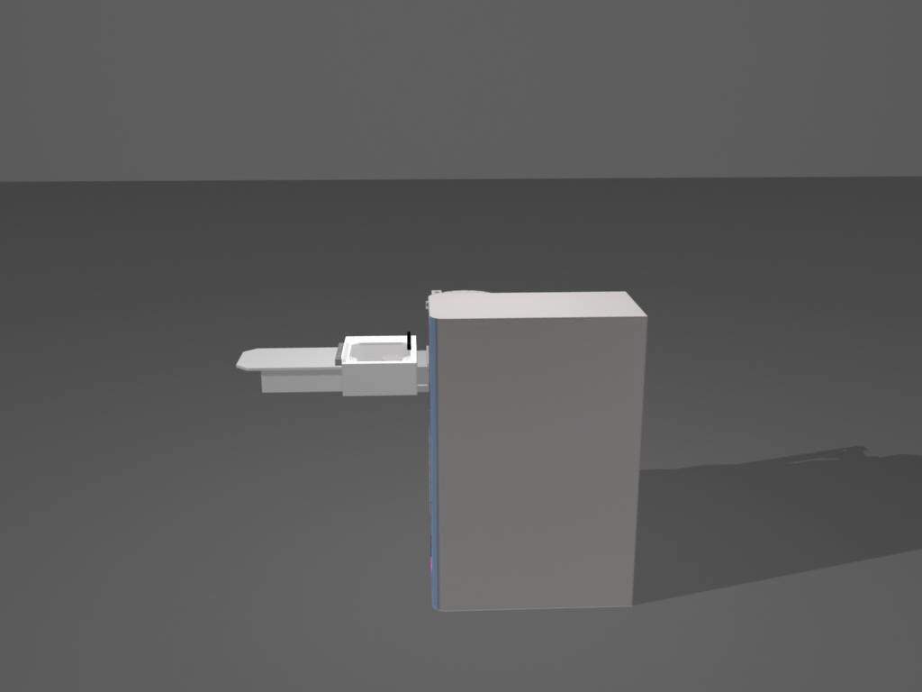
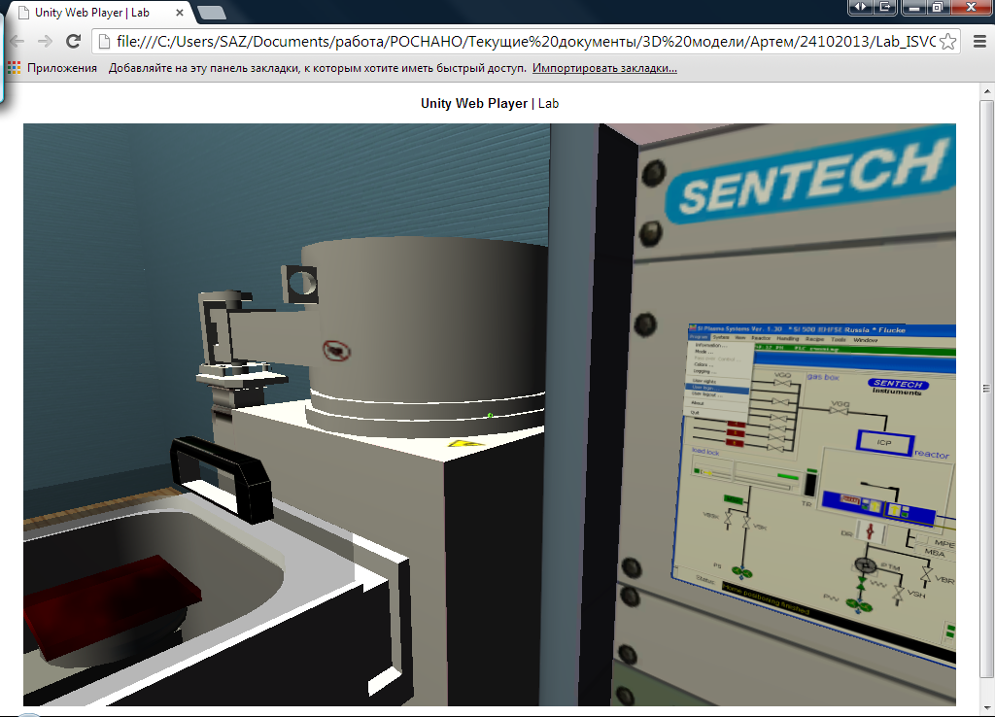
Учебные 3D Модели
Notes:
Our firm successfully сreated innovative educational products, virtual research laboratories, inerractive 3D models.
Thanks to virtual computer simulators the trainee gains practice in conditions to the maximum corresponding to real, and deals only with an electronic virtual prototype of real installations.

Slide 7
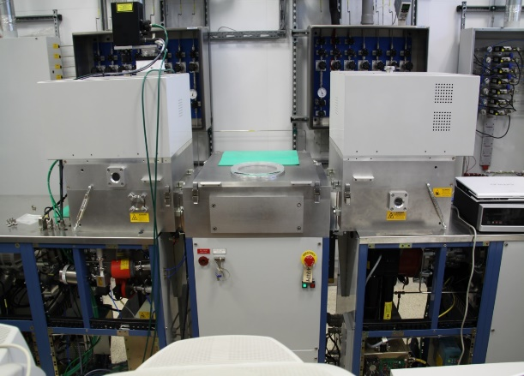

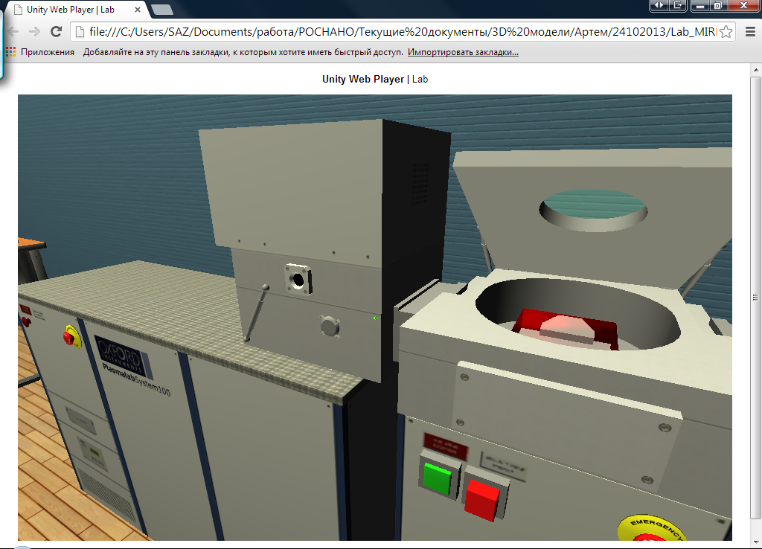
Учебные 3D Модели
Notes:
Virtual training simulation is a perfect teaching environment. Virtual model perception, having high degree of reliability, allows to give effective and quick training to specialists in different areas: technological process control, technical resources management, aviation, medicine, etc.
Systeminvest has created a training simulation system (TSS) for the Russian nanotech within the contract with RUSNANO.

Slide 8
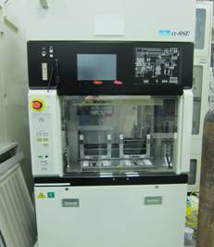
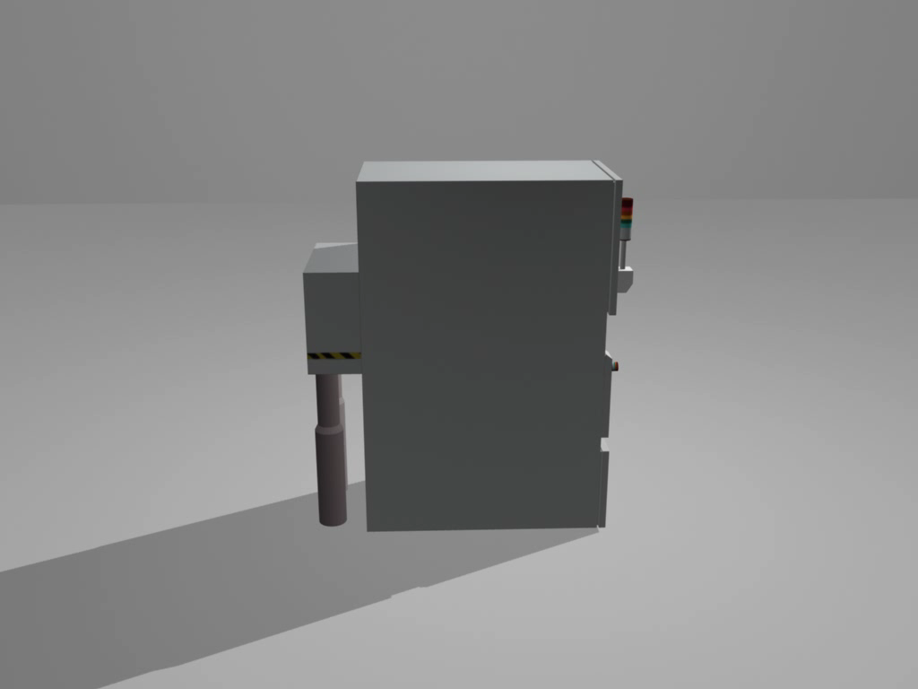
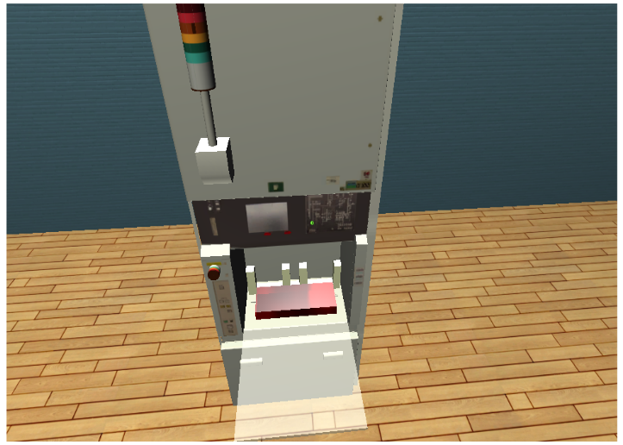
Учебные 3D Модели
Notes:
User works with a simulator that emulates the hardware and software management.
Virtual simulators provide for the opportunity to model the dynamics and interaction of mechanical, electronic, hydraulic, thermodynamic and other processes.

Slide 9
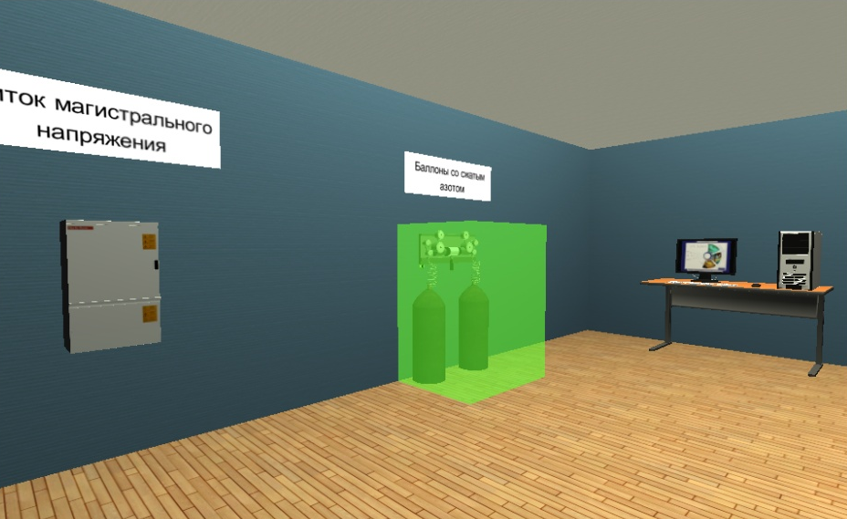
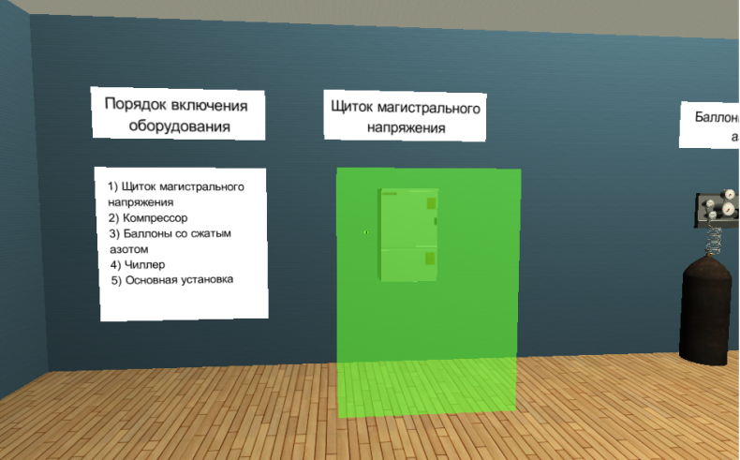
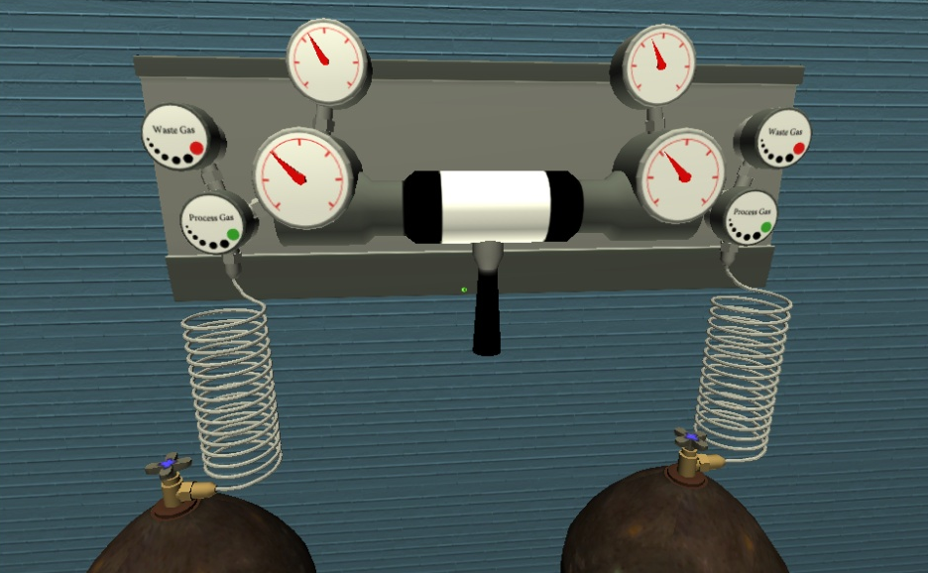
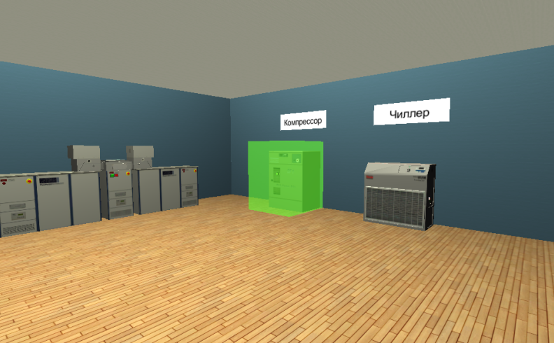
Учебные 3D Модели
Notes:
User works with a simulator that emulates the hardware and software management.
Virtual simulators provide for the opportunity to model the dynamics and interaction of mechanical, electronic, hydraulic, thermodynamic and other processes.

Slide 10
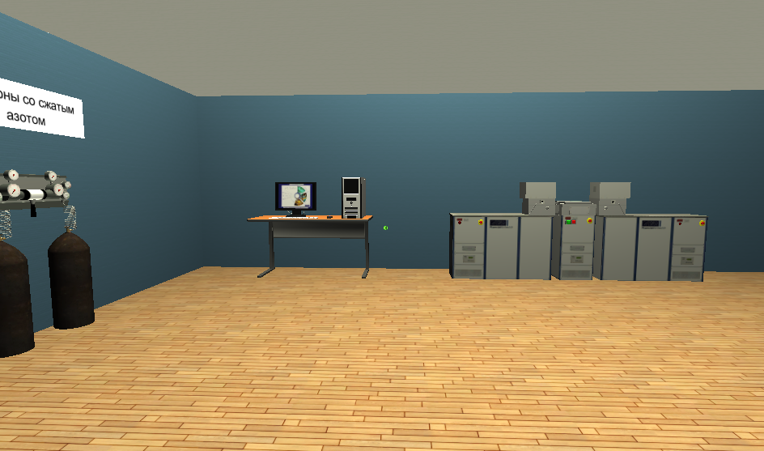
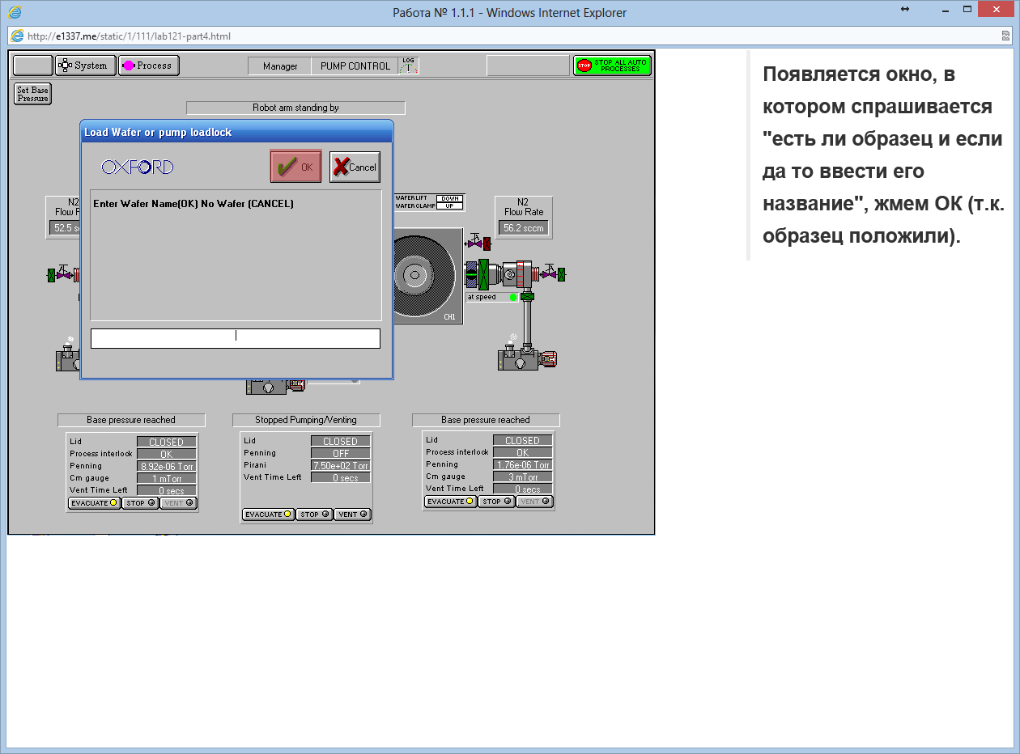
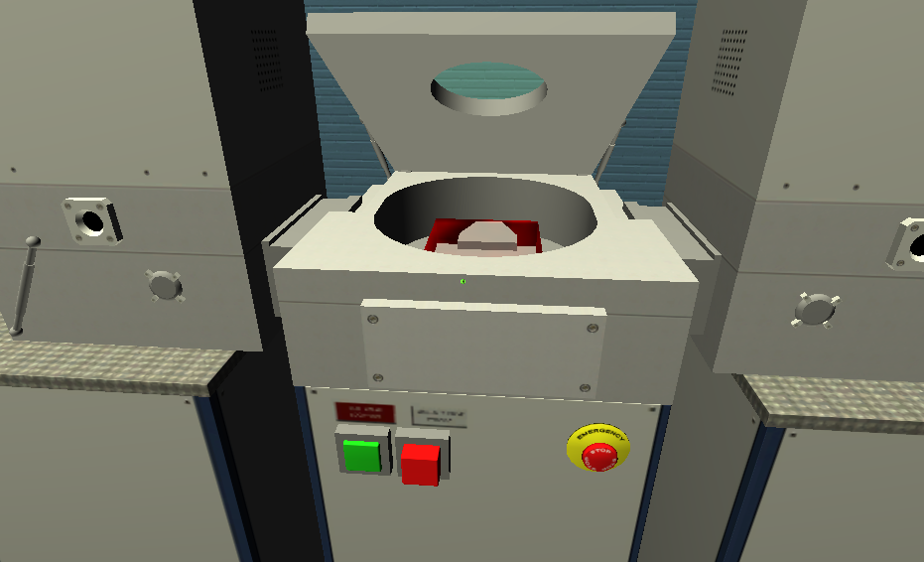
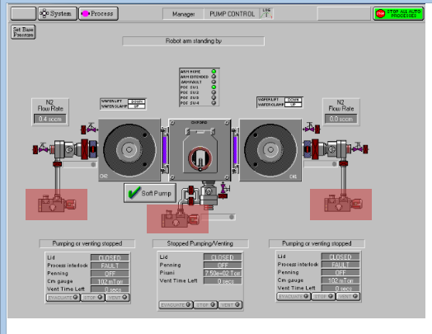
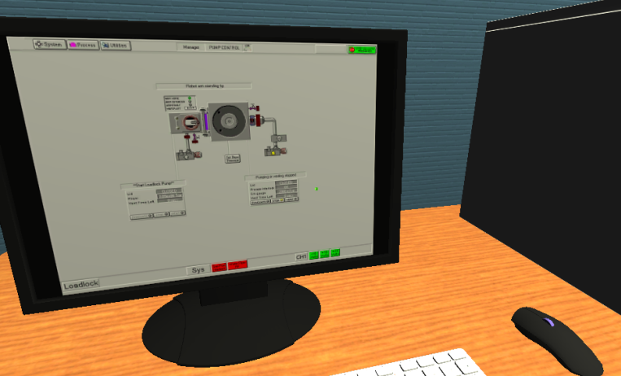
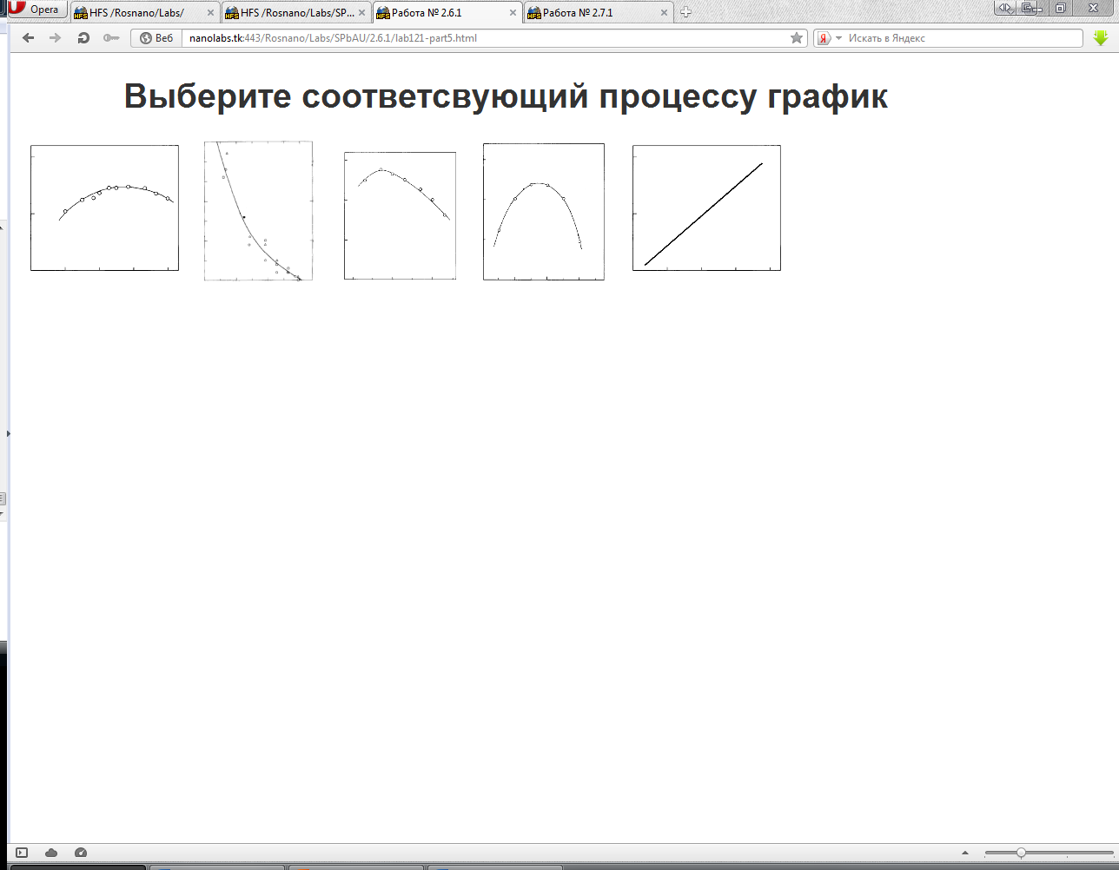
Интерактивные КУРСЫ – Эмуляторы
Notes:
User works with a simulator that emulates the hardware and software management.
Virtual simulators provide for the opportunity to model the dynamics and interaction of mechanical, electronic, hydraulic, thermodynamic and other processes.

Slide 11
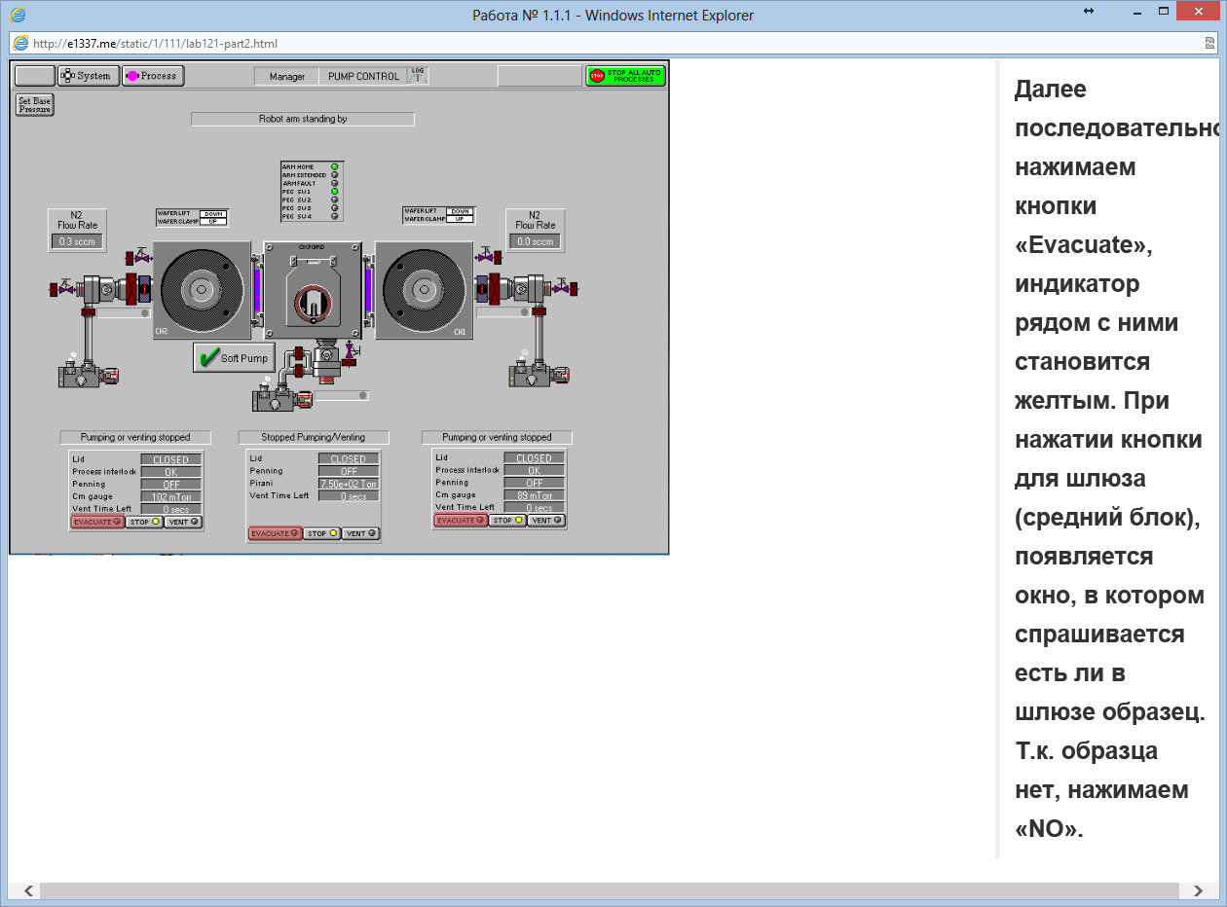
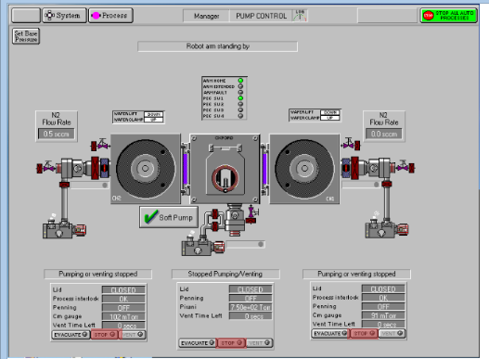
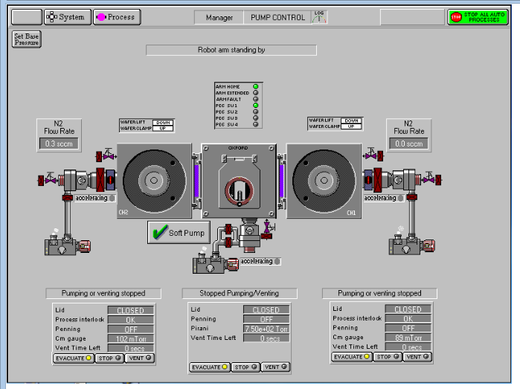
СИМУЛЯТОРЫ ПРОГРАММНОГО ОБЕСПЕЧЕНИЯ
Notes:
The necessity to develop virtual laboratories arises due to the fact that the higher technical education now requires efficiency in training practical skills, skills to operate the equipment, and consolidate the experimental material.

Slide 12
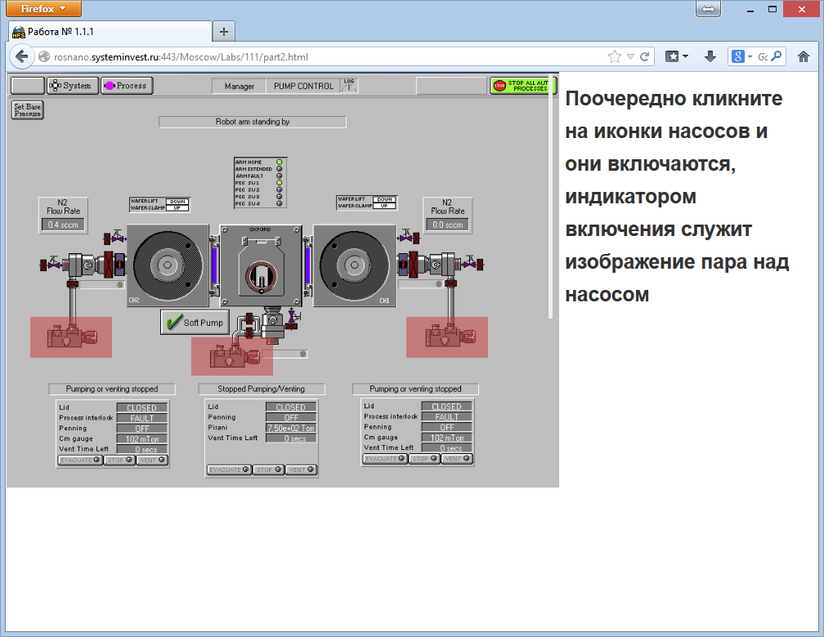
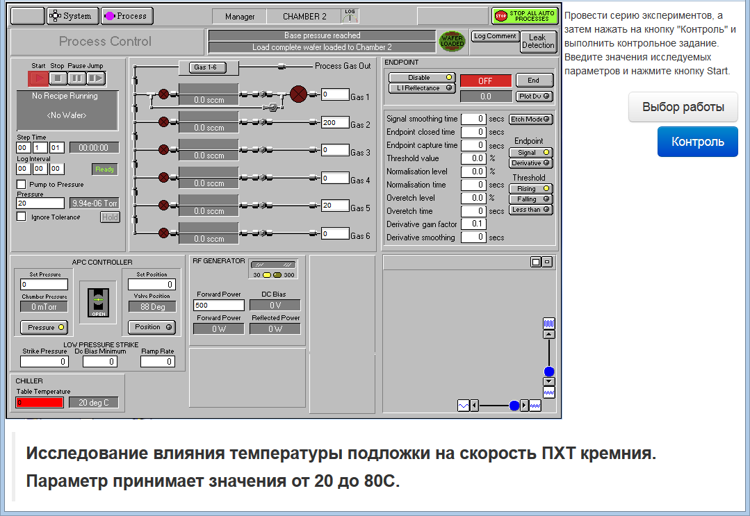
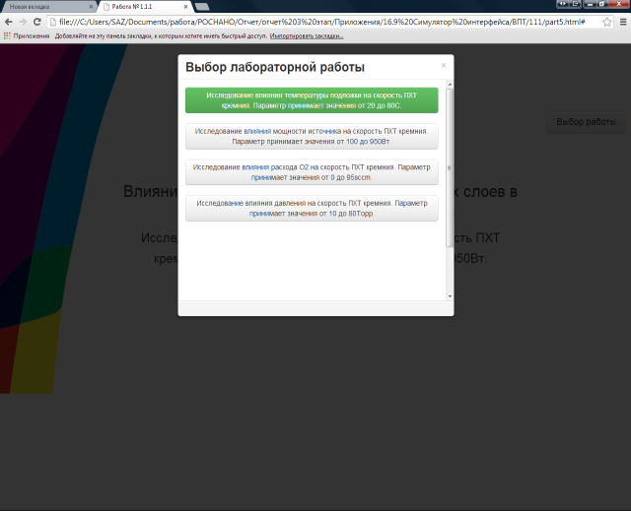
СИМУЛЯТОРЫ ПРОГРАММНОГО ОБЕСПЕЧЕНИЯ
Notes:
The necessity to develop virtual laboratories arises due to the fact that the higher technical education now requires efficiency in training practical skills, skills to operate the equipment, and consolidate the experimental material.

Slide 13
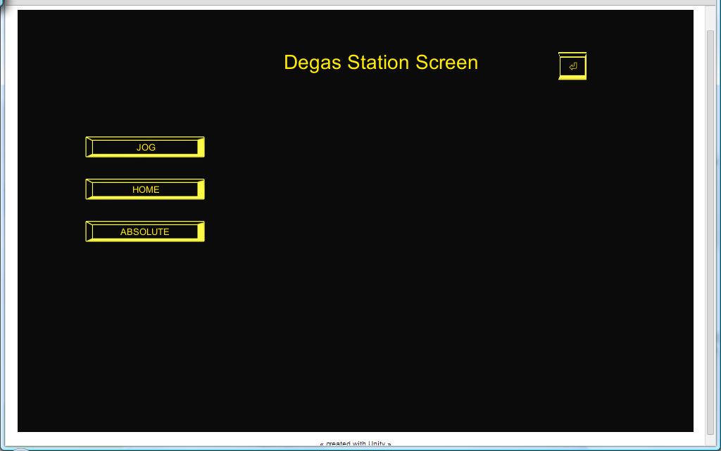
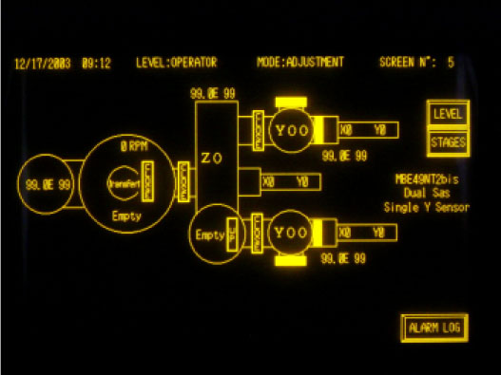
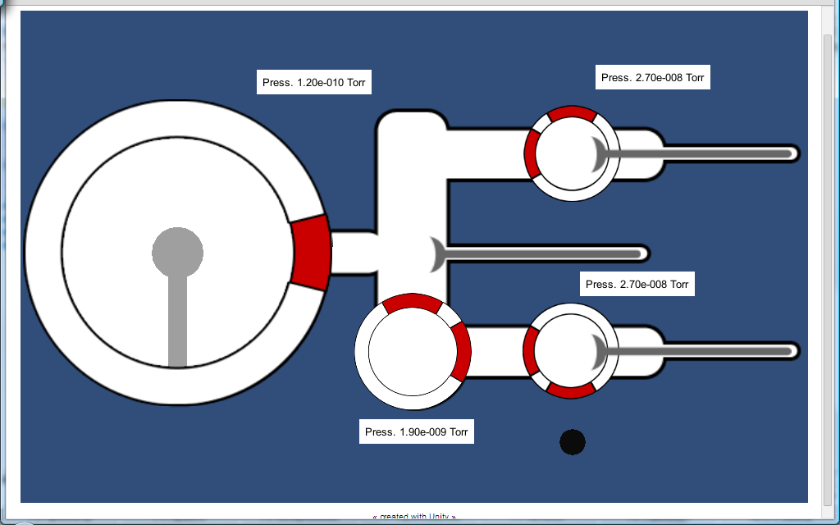
СИМУЛЯТОРЫ ПРОГРАММНОГО ОБЕСПЕЧЕНИЯ
Notes:
The necessity to develop virtual laboratories arises due to the fact that the higher technical education now requires efficiency in training practical skills, skills to operate the equipment, and consolidate the experimental material.

Slide 14
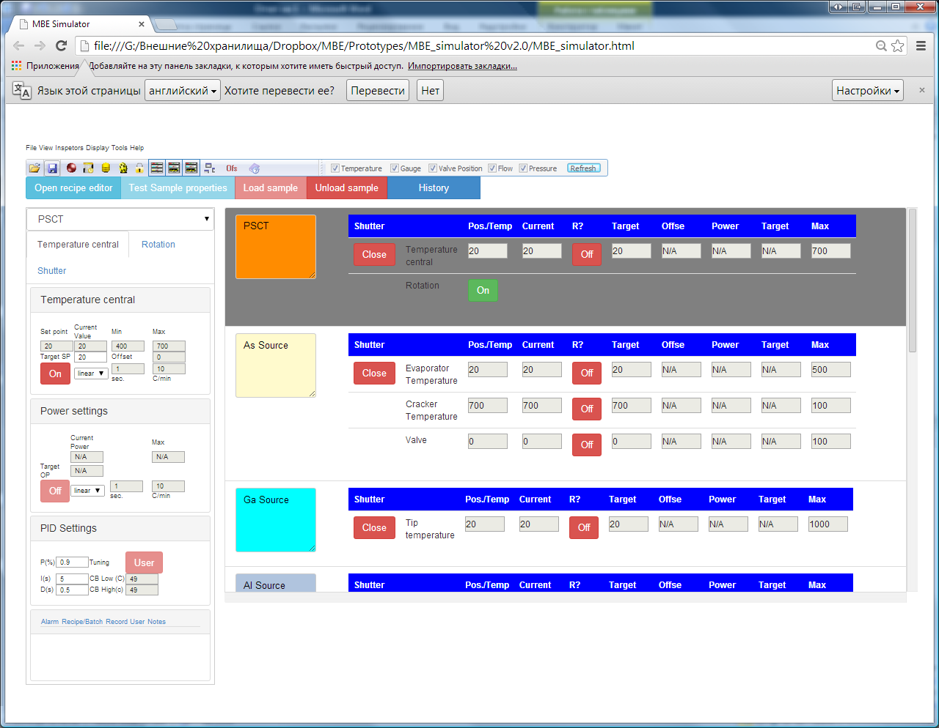
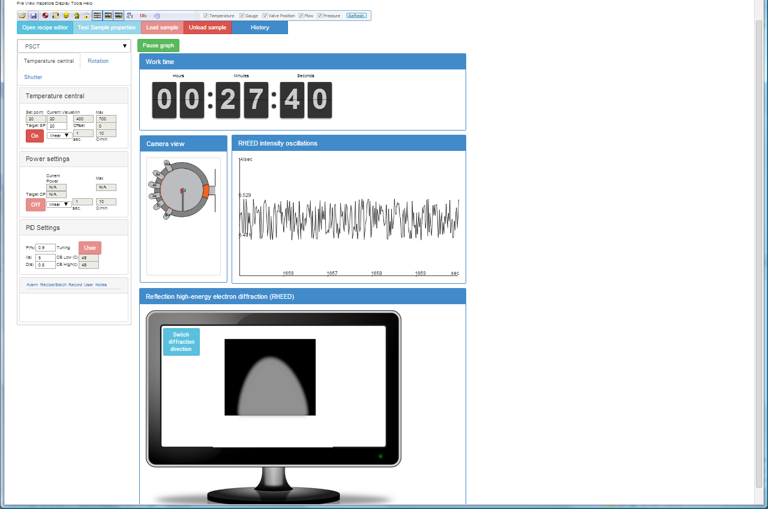
СИМУЛЯТОРЫ ПРОГРАММНОГО ОБЕСПЕЧЕНИЯ
Notes:
The necessity to develop virtual laboratories arises due to the fact that the higher technical education now requires efficiency in training practical skills, skills to operate the equipment, and consolidate the experimental material.

Slide 15
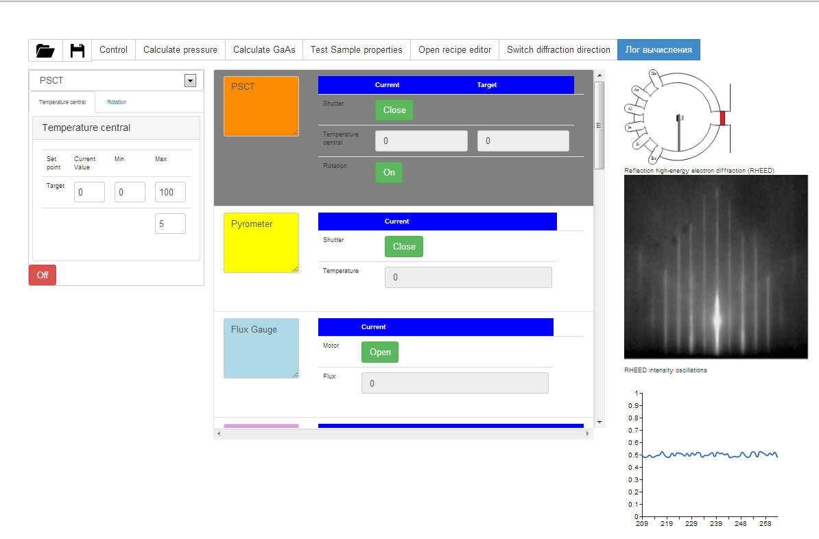
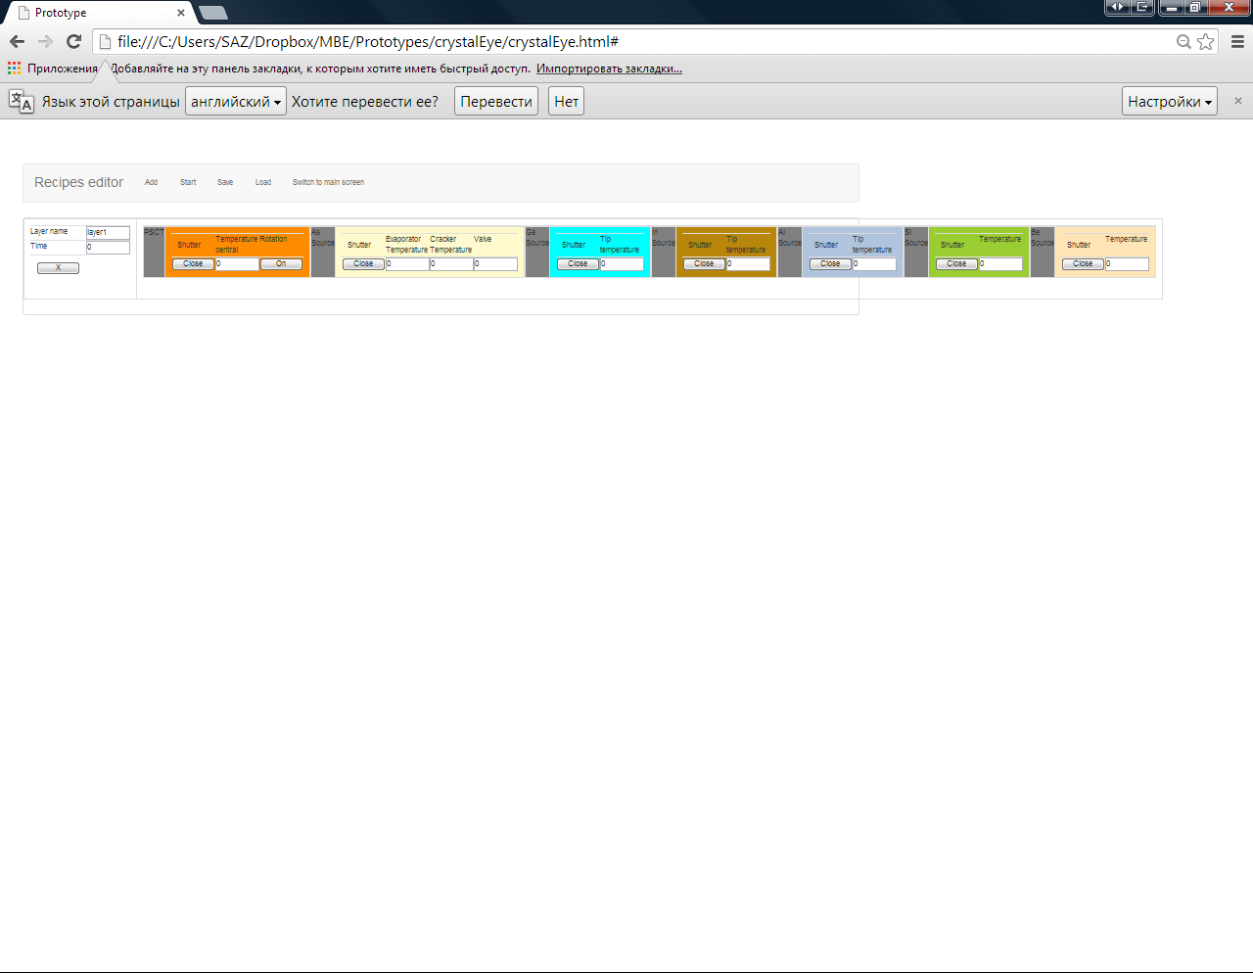
СИМУЛЯТОРЫ ПРОГРАММНОГО ОБЕСПЕЧЕНИЯ
Notes:
The necessity to develop virtual laboratories arises due to the fact that the higher technical education now requires efficiency in training practical skills, skills to operate the equipment, and consolidate the experimental material.

Slide 16
ЗАО «НТЦ Системинвест»
115280, Москва, ул. Велозаводская, 4
E-mail: info@systeminvest.ru
+7 (495) 565-35-60
http://www.systeminvest.ru

